Slide 1
Meeting Week 2 – Hybrid modeling Dual-Gantry
Last week summary
  Key metric
Model for Region of Interest
Kessels Extension and Augmentation method
Orthogonal Regularization
Question 1-4
Outline ToDo next week
  Experiment design
  Simulation

Slide 2
Last week summary
Critical metric: settling error bounds
  For performance: initial movement reference tracking not as important
    Hysteresis is also applicable (= previous movements effects gantry initial movement)
Generic approach for obtaining data for experiments
  Need to design “smart” tests rich in information and for unseen data validation
  Would be beneficial if its applicable on other setups
Augmentation Kessels was effective on wire bonder → proposes orthogonality in limitations
  Discussed two methods for orthogonality: Orthogonal Parameterization and Orthogonal Regularization
Look at mapping multiple nonlinearities, unseen flexible modes → Kessels solves this by:
  Extension: fixes unseen flexible modes
  Augmentation: mapping multiple nonlinearities
Notes:
I will not touch experiment design yet.

Slide 3
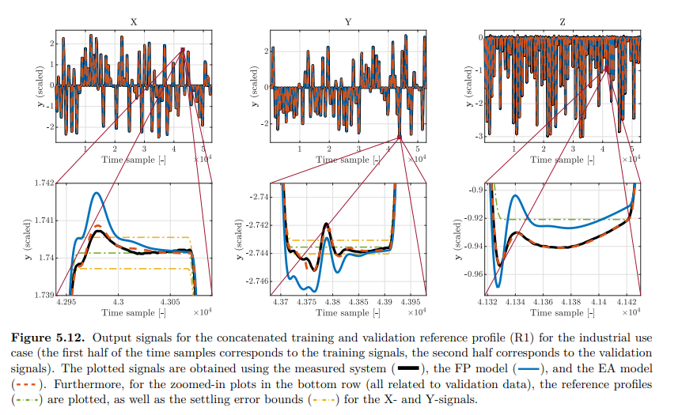
Settling error bound for Dual-Gantry
Bas Kessels paper
maximum allowed deviation of the system's output (position) from the reference trajectory after a specific amount of time has passed (the "settling time") / settling phase: the moments immediately after the reference profile reaches its target position.
FP often fails due to unmodeled dynamics
Goal of augmentation: reduce settling error bounds from FP model / telica settle times as baseline
Instead of RMSE → Target the Peaks; Settling time is determined by the last peak that exceeds the yellow limit line. Even with low RMSE peak could exceed
Feature selection Time Extremum (TE): magnitude and temporal location of local extrema (peaks and valleys) in the error signal; Kessels in application found not to be useful → instead weighted cost function for the peaks?
(Define start and end settling: reference trajectory velocity and acceleration 0 end when new movement begins)

Slide 4
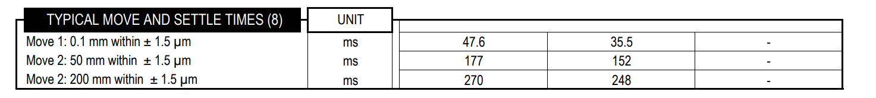
Settling error bound for Dual-Gantry
Bas Kessels paper
maximum allowed deviation of the system's output (position) from the reference trajectory after a specific amount of time has passed (the "settling time") / settling phase: the moments immediately after the reference profile reaches its target position.
FP often fails due to unmodeled dynamics
Goal of augmentation: reduce settling error bounds from FP model / telica settle times as baseline
Instead of RMSE → Target the Peaks; Settling time is determined by the last peak that exceeds the yellow limit line. Even with low RMSE peak could exceed
Feature selection Time Extremum (TE): magnitude and temporal location of local extrema (peaks and valleys) in the error signal; Kessels in application found not to be useful → instead weighted cost function for the peaks?
(Define start and end settling: reference trajectory velocity and acceleration 0 end when new movement begins)

Slide 5
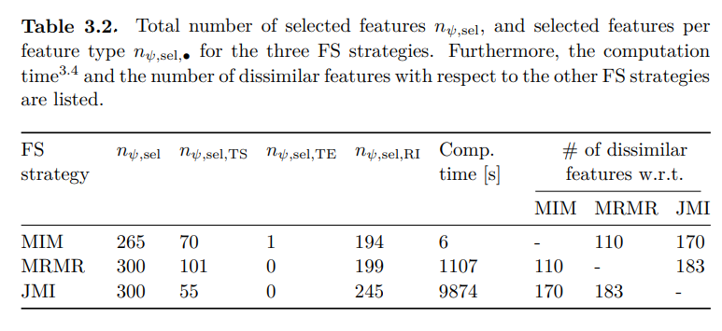
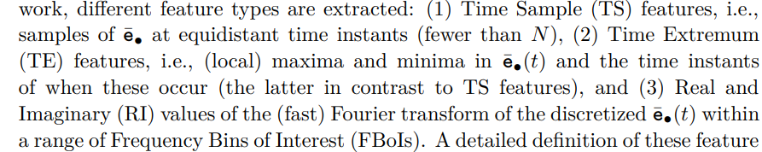
Settling error bound for Dual-Gantry
Bas Kessels paper
Instead of RMSE → Target the Peaks; Settling time is determined by the last peak that exceeds the yellow limit line. Even with low RMSE peak could exceed
Feature selection: Extract a subset of highly informative features extracted from time-series data.
  Time Extremum (TE) Limitation: Kessels showed that extracting local extrema features is often suboptimal for industrial systems due to noise sensitivity and low information density→ For dual-gantry cost function: peak-weighted or time-weighted penalty
  Real and Imaginary (RI) parts of the Fourier Transform were the most effective features.
    Relatively informative and robust, unlike magnitude/phase features, where the phase can look very similar for different parameter combinations
  Time Sample (TS) features were the second most important group.
Notes:
Kessels found that while TE features (magnitude and timing of peaks) are physically intuitive, they are often comparatively inaccurate in industrial applications because they are sensitive to measurement noise and contain low information density (sparsity) compared to using full time-samples or frequency-domain data
Real and Imaginary (RI) parts of the Fourier Transform were the most effective features.
Why they are good: Kessels notes that RI features are "relatively informative" and robust. Unlike Magnitude/Phase (MP) features, where the phase can look very similar for different parameter combinations
Time Sample (TS) features were the second most important group.
JMI Strategy MRMR Strategy MIM Strategy
(Define start and end settling: reference trajectory velocity and acceleration 0 end when new movement begins)
Time Extremum (TE) Limitations to justify Cost Function, but clarify that this is a training objective choice, not a feature input choice.

Slide 6
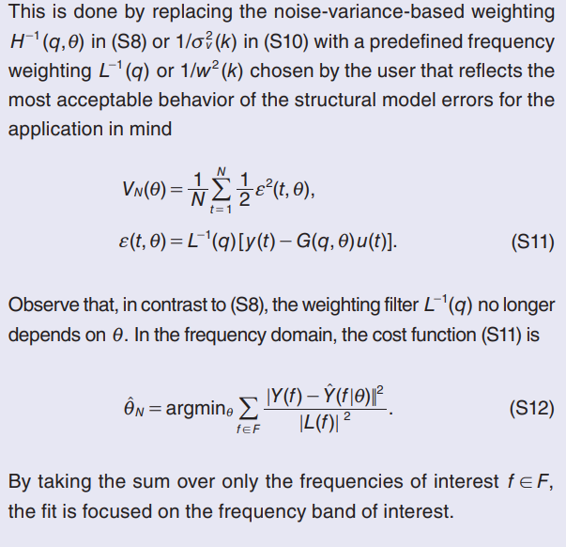
Region of interest & Targeting the peaks
Schoukens & Ljung
Wet-Clutch example for dual-gantry
  Design “spiky” position commands to make the response settling-dominated. Superimpose a multisine to identify local dynamics
Weighting function L(q): tells the optimizer where accuracy matters
  Acts as a pre-filter to the prediction error before computing the cost → result minimize a weighted (filtered) error
  Choose L to specify which frequencies require more accuracy
  Need to translate time-domain requirement (stay within ±1.5 µm) into a frequency domain instruction for the optimizer
Notes:
This concept addresses Experiment Design. You cannot learn to settle fast if your training data doesn't contain aggressive moves that cause settling errors.
The Problem: Standard identification signals (like Gaussian noise or simple sine waves) often stay in the "linear" region of a system. They do not excite the specific nonlinear behaviors that happen during hard operations.
Superimposed Multisine: Once the system is in that critical state (e.g., the gantry has arrived and is vibrating), they superimposed a small-amplitude multisine signal.
Why do this? The "spike" forces the system to the operating point where the error matters (the crash/stop), and the "multisine" acts as a probe to identify the local dynamics (stiffness/damping) specifically at that difficult moment
For Dual-Gantry: This means you should not just train on random noise. You must train on "Step + Noise" signals: Hard jumps (to trigger the residual vibrations) + small vibrations (to help the Neural Network learn how to dampen them).
Spiky Command: They designed an input with large, sharp spikes (high amplitude) to force the system rapidly into its critical phase (filling the clutch / moving the gantry)
superimpose a multisine onto a spiky trajectory to create a "Rich Spiky Signal.“
Spike: take the specific trajectory you need (e.g., the rapid engagement profile or your gantry's stop-start motion). You create a band-limited approximation of this "spike" forces the system into the correct operating regime.
Multisine: add a small-amplitude, flat-spectrum multisine on top of it
Normally, Maximum Likelihood estimation weights errors by the Noise
This means you filter the error signal before squaring it.
The Mechanism: If you want the model to be extremely accurate at a specific frequency (e.g., the resonance frequency causing your settling vibrations), you choose a weighting function L(f) that is very small at that frequency.
▪ The Result: Because you divide by a small number, the "cost" for errors at that frequency becomes huge. The optimizer is forced to work extra hard to fix the model at that specific resonance, even if it ignores errors elsewhere
Use a chosen weighting filter instead of a noise-based weighting tries to be optimal if your model structure is correct and noise assumptions hold.
Kessels Application
Imitating Operation (Input Design): Instead of abstract random noise, Kessels generates training data using "alternating smoothed step-up and step-down profiles." These explicitly mimic the reference profiles used during the machine's actual operation to capture relevant behavior
Implicit Filtering (Feature Selection): He replaces standard frequency weighting (L) with Feature Selection on "Frequency Bins of Interest" (FBoIs). The method extracts specific frequency ranges (e.g., near eigenfrequencies) and uses Mutual Information algorithms (like JMI) to discard noisy or irrelevant bins, effectively filtering the error signal
Regime Forcing (Closed-Loop): Similar to the "Wet-Clutch" high-pressure requirement, Kessels uses Closed-Loop Feedback during data generation. This forces the system to track the reference steps, ensuring the dataset is rich in the specific settling dynamics required for the high-precision application

Slide 7
Kessels Application
Imitating Operation (Input Design): Instead of abstract random noise, Kessels generates training data using "alternating smoothed step-up and step-down profiles." These explicitly mimic the reference profiles used during the machine's actual operation to capture relevant behavior
Implicit Filtering (Feature Selection): He replaces standard frequency weighting (L) with Feature Selection on "Frequency Bins of Interest" (FBoIs). The method extracts specific frequency ranges (e.g., near eigenfrequencies) and uses Mutual Information algorithms (like JMI) to discard noisy or irrelevant bins, effectively filtering the error signal
Regime Forcing (Closed-Loop): Similar to the "Wet-Clutch" high-pressure requirement, Kessels uses Closed-Loop Feedback during data generation. This forces the system to track the reference steps, ensuring the dataset is rich in the specific settling dynamics required for the high-precision application

Slide 8
Extension and Augmentation (EA)
Kessels
Goal: fix mismatch between theoretical First Principles (FP) model and the real physical system
Extension: introduce new state variables that capture unmodeled dynamics
  Subspace Encoder (NN) looks at past data and estimates hidden states
Augmenation: Physical model might have incorrect parameters (or simplified equations)
  EA adds RNNs directly into the force/accelerations equations of the physical model
Negation Problem: NN cancels out physical parameters; NN might take easy route and learn simple dynamics and not the nonlinearities
  Mentions for further research Orthogonality to improve on negation effect
Notes:
The EA Solution:
• New Variables: EA mathematically extends the state vector. If your model has 2 states [x,x˙], EA adds [z1​,z2​] to track the unmodeled vibrations
The Subspace Encoder: Since you cannot measure these new "hidden" vibration states directly with sensors, you use a Subspace Encoder. This is a Neural Network that looks at a window of past input/output data (history) to estimate what these hidden states are at the current moment
Dynamics: A Recurrent Neural Network (RNN) learns how these new states evolve over time (e.g., how the vibration decays
The EA Solution:
• Force Injection: EA augments the existing equations. It injects a "correction force" directly into the acceleration equation of the FP model
◦ Standard FP: a=Finput​/m
◦ Augmented: a=(Finput​/m)+RNNcorrection​
Dynamics (The RNN): Once initialized by the encoder, the evolution of these new states is governed by a Recurrent Neural Network (RNN). In his mechanical use cases, he explicitly imposes a second-order structure (position/velocity pairs) on these new states to mimic physical laws, but their behavior is learned entirely from data

Slide 9
Orthogonality
Orthogonal by construction (ObC) requires input-output, realistic for the dual-gantry system?
For the dual-gantry system due to multivariable (MIMO) coupling and for physical interpretability → state space the best option
Notes:
Orthogonal by construction currently states that further research for state-space needs to be done
resonance frequencies = poles
Dual-gantry: position-dependent dynamics and cross-coupling between gantries
Definition of Internal Dynamics (NIIR): These models have a nonlinear feedback loop. The nonlinearity isn't just applied to the input (external); it is part of the system's internal memory loop.
When to Use Them: You must use this class of models if your system shows strong nonlinear behaviors like:
◦ Moving Resonances: The resonance frequency shifts as the operating point or excitation amplitude changes (crucial for dual-gantry).

Slide 10
Orthogonal Regularization (State-Space)
Add penalty term to the optimization cost function for predictions that look like rigid-body physics
Use simulated states generated by FP model to construct projection matrix → compatible with Nonlinear State-Space
Linearization point can be updated at each iteration using the current estimate
  Requires recomputing SVD and projection matrix every time the cost function is evaluated → computation expensive
  Only initialize projection matrix at the start of training with initial best guess estimate of the physical parameters → telica datasheets available
Notes:
Orthogonal Regularization for physical parameters vs prediction accuracy for the EA method
add a penalty term to the cost function. This penalizes the neural network if its output lies in the same mathematical subspace as the physical model's output.
• Why simulated? In "Orthogonal-by-Construction" methods for input-output models, you use past measured data to build the projection matrix. However, for a State-Space model (like your dual-gantry), the internal states (velocities, flexible modes) are often not fully measured.
The Method: use the simulated states (x^) generated by your First-Principles (FP) model to construct the Jacobian (sensitivity matrix). This allows you to apply orthogonality even to latent/hidden states, making it compatible with nonlinear state-space formulations where full state measurement is impossible.

Slide 11
LPV-LFR

Slide 12
Combining EA with Orthogonality
EA continuously updates physical parameters
Nominal approximation: Initialize SVD once to build projection matrix Π.
  Ideally we would update the SVD at every update step
Notes:
Why "EA continuously updates" is a problem for Orthogonality In standard "serial" grey-box modeling, you might fix the physical parameters and then train a network. But in your EA method, you are doing joint estimation—updating the mass/stiffness
• The Logic: Even though the datasheets aren't perfect (that's why you are updating them), they capture the general rigid-body behavior (mass/geometry) correctly.
• The Theoretical Ideal: Adaptive Orthogonality
◦ To ensure strict orthogonality, we should re-linearize the physical model around the current θ^ at every iteration.
◦ Drawback: This requires re-computing the Jacobian and performing an SVD at every step, which is computationally prohibitive
The Practical Solution: Nominal Approximation
◦ Method: We calculate the Jacobian and Projection Matrix (Π) once at the start, using the nominal parameters (θ0​) from the Telica datasheets

Slide 13
Nonlinear System Identification
Schoukens & Ljung, Kessels
OMNIPUS (OptiMized Nonlinear InPUt Signal): Instead of random noise, generates randomized step-like sequences
  Models better to unseen data
  OMNIPUS responsible for global movement for covering the full operating space. Combine with “Wet-Clutch Trick” for local excitation
Selecting regime points for the dual-gantry system
  Need to select specific coordinates that represent extreme cases
  Automate with HILOMOT (HIerarchical LOcal MOdel Tree) algorithm
Notes:
1. OMNIPUS (OptiMized Nonlinear InPUt Signal)
• What it is: Instead of using standard white noise (which concentrates energy around zero), OMNIPUS generates randomized step-like sequences.
• Why use it for the Gantry:
◦ Constraint Handling: It respects physical limits (amplitude and gradients) while maximizing coverage of the operating space.
2. Combining OMNIPUS with the "Wet-Clutch Trick"
You should explain this as a "Global vs. Local" identification strategy.
• OMNIPUS (Global Position): Use the randomized steps of OMNIPUS to move the gantry to specific positions (x,y) within the workspace. This handles the position-dependent nature of the system (moving to where the stiffness changes).
• Wet-Clutch Trick (Local Dynamics): Once the OMNIPUS signal holds the gantry at a specific "step" (regime point), you superimpose a small-amplitude Multisine.
◦ Purpose: This excites the local flexible modes (resonances) at that specific position.
◦ Result: You get a high-fidelity snapshot of the frequency response (stiffness/damping) at every critical position in the workspace, solving the "moving resonance" problem .
• The Solution: HILOMOT is an algorithm that automatically partitions the input space.
Because cant visit every coordinate
• How it works:
1. Start with a single global linear model for the whole gantry workspace.
2. Calculate the local error across the workspace.
3. Split the space: The algorithm automatically splits the input space (the XY positions) into two halves at the location where the local error is worst.
4. Repeat: It continues to split these regions into smaller "leaves" (local models) until the error is acceptable everywhere [Source 0, 87].
• Why for Gantry: This is ideal for position-dependent stiffness because it will automatically place more regime points in areas where the stiffness changes rapidly (likely near the center of the travel range) and fewer points where behavior is linear/consistent (near the supports) [Source 0, 87].

Slide 14
Question 1
In the First Principles (FP) model you are developing, how exactly is the decoupling formulated? Is it modeled as two completely independent SISO systems (where Axis X ignores Axis Y), or does it contain static coupling terms?
Are the physical parameters (mass, stiffness) in this FP model lumped parameters, or are they distributed? I need to know which specific parameters (θbase​) I am allowed to update/tune versus which ones are fixed structure. → coupling?
The Garcia-Herreros paper demonstrates that Modal Decoupling—mathematically transforming the axes into 'Translation X' and 'Rotation Θ' modes—reduces positioning error by over 50% compared to standard independent control.
However, my notes indicate that the ETEL hardware architecture likely prevents us from modifying the low-level feedback loops to implement this decoupling directly in the controller.
Therefore, for the LPV-LFR model structure: Should I assume the Baseline Model (fbase​) operates in 'Independent/Master-Master' mode (where the physics model ignores the cross-arm connection)?
• If yes: My Neural Network (faug​) must be explicitly designed to learn the rigid-body mechanical coupling (X1​↔X2​ interaction) that the independent baseline ignores.
• If no: Does the current Feedforward model already include a decoupling matrix that I should incorporate into my baseline to avoid re-learning known physics?"
Notes:
The Garcia-Herreros paper demonstrates that Modal Decoupling (separating Translation X and Rotation Θ) reduces error by 50% compared to Independent SISO control.
However, my notes indicate we cannot implement this decoupling strategy, likely due to the ETEL hardware constraints preventing us from modifying the feedback loop topology.
Therefore: Should my Neural Network assume the baseline operates in 'Independent/Master-Master' mode? If so, my Network must specifically learn the mechanical coupling terms (X1​↔X2​ interaction) that the Modal strategy would have removed, but the Independent strategy ignores.

Slide 15
Question 1
How is decoupling formulated in the FP model?
  ETEL limits ability to implement the modal decoupling control?
  Is it modeled as two fully independent SISO systems, independent control?
  Or does the FP model include static coupling terms (or a coupling matrix) that captures cross-axis interaction?
Notes:
The Garcia-Herreros paper demonstrates that Modal Decoupling (separating Translation X and Rotation Θ) reduces error by 50% compared to Independent SISO control.
However, my notes indicate we cannot implement this decoupling strategy, likely due to the ETEL hardware constraints preventing us from modifying the feedback loop topology.
Therefore: Should my Neural Network assume the baseline operates in 'Independent/Master-Master' mode? If so, my Network must specifically learn the mechanical coupling terms (X1​↔X2​ interaction) that the Modal strategy would have removed, but the Independent strategy ignores.
master–master/independent control
1. What are "Static Coupling Terms"?
In the context of the First Principles (FP) model for a dual-gantry, static coupling terms are the specific coefficients in the equations of motion that mathematically link the behavior of Axis 1 (X1​) to Axis 2 (X2​). If these terms are present (non-zero), the model predicts that moving one motor will physically pull or push the other.
Why you are asking this: You need to know if their FP model includes these terms (a Coupled MIMO model) or if it sets them to zero (two Independent SISO models).

Slide 16
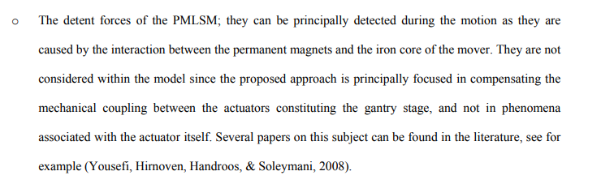
Question 2
Regarding the unmodeled dynamics causing the settling error: Is the dominant cause considered “unknown” (missing from the equations) or “hard-to-model” (simplified in the equations)?
  Hypothesis for the dominant physical cause of the settling error?
    Model-based decoupling paper: detent forces
      Forces generated by the Permanent Magnet Linear Synchronous Motors (PMLSM)
Notes:
What the augmentend model should capture.
Does enforcing a static orthogonality constraint based on center-dynamics create a validity gap at the workspace extremities? Specifically, do we risk incorrectly penalizing the Neural Network for learning valid local stiffness variations at the corners because they fall into the 'forbidden subspace' defined only for the center?“
Reasoning: If modes are missing, I must prioritize the Subspace Encoder to 'discover' them. If it is just complex forces, I can focus on Neural Network Augmentation to learn the nonlinear map."
Gantry Paper explicitly states that base frame resonances were unknown/ignored until observed in data (requiring Extension), while detent forces were known but "not considered within the model" because they were too complex/distracting for the control strategy (requiring Augmentation)

Slide 17
Question 3
In the case the neural network is able to capture the 'missing physics’, what is the implementation strategy for the feedforward?
  Direct Inversion: Mathematically invert augmented model to generate a more accurate reference force
  Add-on Correction: Neural network output as an additive “correction signal” on top of the existing feedforward?
Notes:
Does enforcing a static orthogonality constraint based on center-dynamics create a validity gap at the workspace extremities? Specifically, do we risk incorrectly penalizing the Neural Network for learning valid local stiffness variations at the corners because they fall into the 'forbidden subspace' defined only for the center?“
Direct Inversion:
Definition: This approach assumes you have a perfect mathematical model of the system (Baseline + Augmentation) and you mathematically solve it backwards. Given a desired trajectory yref​ (position), you calculate exactly what input force u is required to produce it.
If your augmented model uses a complex Neural Network, calculating the mathematical inverse in real-time is computationally expensive and prone to numerical errors.
Add-on Correction (The "Parallel" Strategy)
Definition: This approach keeps your existing standard Feedforward (based on rigid-body physics) and uses the Neural Network only to predict the "force error" (disturbance) that the standard model misses. This prediction is added as a correction signal.

Slide 18
Question 4
Is there a preference for continuous- or discrete time for the model?
  DT?

Slide 19
Outline next week
Map the dual-gantry physics into Phd supervisor LPV-LFR code structure
  Simulate model augmentation for dual-gantry
  LPV-LFR splits model into 2 blocks
    Constant linear dynamics
    Varying elements
Proposition experiment design
  for combined EA + Orthogonality method
Notes:
You are using LPV-LFR because it allows you to keep your First Principles (rigid body) model separate and constant (in the G block), while isolating the position-dependent couplings and Neural Network augmentations in the feedback loop (Δ block). This makes the physics interpretable and allows the model to handle the gantry's shifting resonances efficiently.
LPV-LFR is a modeling architecture that splits a complex nonlinear or time-varying system into two distinct blocks connected by a feedback loop:
• The LTI Block (G): This block contains all the constant linear dynamics (matrices A,B,C,D) that do not change. In your case, this represents the rigid-body physics (M,C,K matrices) of the gantry [Source 4, 370].
• The Delta Block (Δ(p)): This block contains all the varying elements (parameters p(t)). In your case, this contains the position-dependent stiffness (moving resonance) or the output of the Neural Network [Source 4, 371].

Slide 20
Possible Gantt-chart or Planning
To keep an overview of what the progress overall is.

